Slide 1
Why Firms Make Unilateral Investments Specific to Other Firms: The Case of OEM Suppliers
Min-Ping Kang, Joseph T. Mahoney, Danchi Tan (2009)
Strategic Management Journal

Slide 2
Introduction
Theory and Hypotheses
Method
Results
Discussion
Research Gap
TCE maintains that to mitigate risk, farsighted firms typically use formal contracts and ex post governance mechanisms to safeguard relationship-specific investments.
In business practice, it is common that one firm makes unilateral relationship-specific investments in which reciprocal commitment from the other firm is neither expected nor forthcoming.
For example, OEM suppliers do not receive a reciprocal sunk-cost commitment from the buyer.
TCE considers decisions to make such investments as ‘myopia’.
TCE has focused primarily on the individual transaction as the basic unit of analysis and has not fully explored the possibility that transactions may be interdependent and can have spillover effects.

Slide 3
Introduction
Theory and Hypotheses
Method
Results
Discussion
Research Question
Why do firms sometimes make unilateral relationship-specific investments without financial security?
Go beyond traditional TCE that considers the individual transaction as the unit of analysis, and move toward a broader systems view of transactions
It is rational to take on investment projects, which have negative net present values from the perspective of a single transaction but that have positive overall net present values from a systems view of transactions.
Relationship-specific investments may generate two positive spillover:
Inter-project spillovers with the same transaction partner
Inter-project spillovers with other transaction parties

Slide 4
Hypothesis 1: Knowledge spillovers and economic bonding relationships
Introduction
Theory and Hypotheses
Method
Results
Discussion
OEM suppliers have an opportunity to develop multiple projects and economic bonding relationships with a particular buyer.
OEM suppliers accumulate partner-specific knowledge → develop interorganizational routines → outperform other potential suppliers in future transactions
Suppliers’ relationship-specific investments may increase the economic incentive of their clients to transfer knowledge and information to these suppliers.
Unilateral investments serve as sunk-cost commitments → Reduce buyers’ concerns about information leaking to their competitors → Information sharing and knowledge-sharing
Hypothesis 1: The greater the economic value of inter-project knowledge spillover effects with a particular client, the more likely OEM suppliers will make unilateral relationship-specific investments.

Slide 5
Hypothesis 2: Knowledge spillovers and capability leveraging
Introduction
Theory and Hypotheses
Method
Results
Discussion
The exchange relationship enables the supplier to develop dynamic capabilities.
The OEM supplier can apply its newly created capabilities not only to various stages of vertical supply chain activities with the same buyer, but also to a broader customer scope.
Hypothesis 2: The greater the economic value of inter-project knowledge spillover effects with other clients, the more likely OEM suppliers will make unilateral relationship-specific investments.

Slide 6
Hypothesis 3: Reputation spillovers and endorsement effect
Introduction
Theory and Hypotheses
Method
Results
Discussion
Supplier’s relationship with major OEM buyer can benefit its transactional relationships with other OEM buyers.
Being endorsed by a major OEM buyer reduces the market uncertainty of other buyers concerning the supplier’s capabilities.
Such reputation effects should be highest when there are substantial differences in market status between these transaction parties.
Hypothesis 3: The greater the economic value of reputation spillover effects with other clients, the more likely OEM suppliers will make unilateral relationship-specific investments.

Slide 7
Research setting
Introduction
Theory and Hypotheses
Method
Results
Discussion
Two industries: information technology and bicycles
Features of the IT and bicycle industries:
Commonality
High degree of asset specificity
OEM suppliers play a key role in serving large international brand firms
Vertical de-integration: access international markets by serving international OEM buyers
Difference
Market power difference between OEM suppliers and buyers: high difference between OEM buyers and suppliers in the IT industry; low difference in the bicycle industry
Data collection: Questionnaires for IT industry and on-site interview for bicycle industry

Slide 8
Measurement
Introduction
Theory and Hypotheses
Method
Results
Discussion
Dependent variable
Relationship-specific investment: seven-point Likert scale measure
Tangible investment: physical investment in tooling, equipment, and engineering expenses
Intangible investment: investment in business processes, procedures, and people
Independent variables
Knowledge spillovers
Spillover with the same transactional party: multiple projects and integrated services
Spillover with other transaction parties: capability upgrading
Reputation spillovers
Reputation enhancement scale: positive spillovers that an OEM supplier can generate due to the endorsement effect of a good reputation of its buyer
Control variables: length of association, firm size, relative scales, degree of reciprocal investments

Slide 9
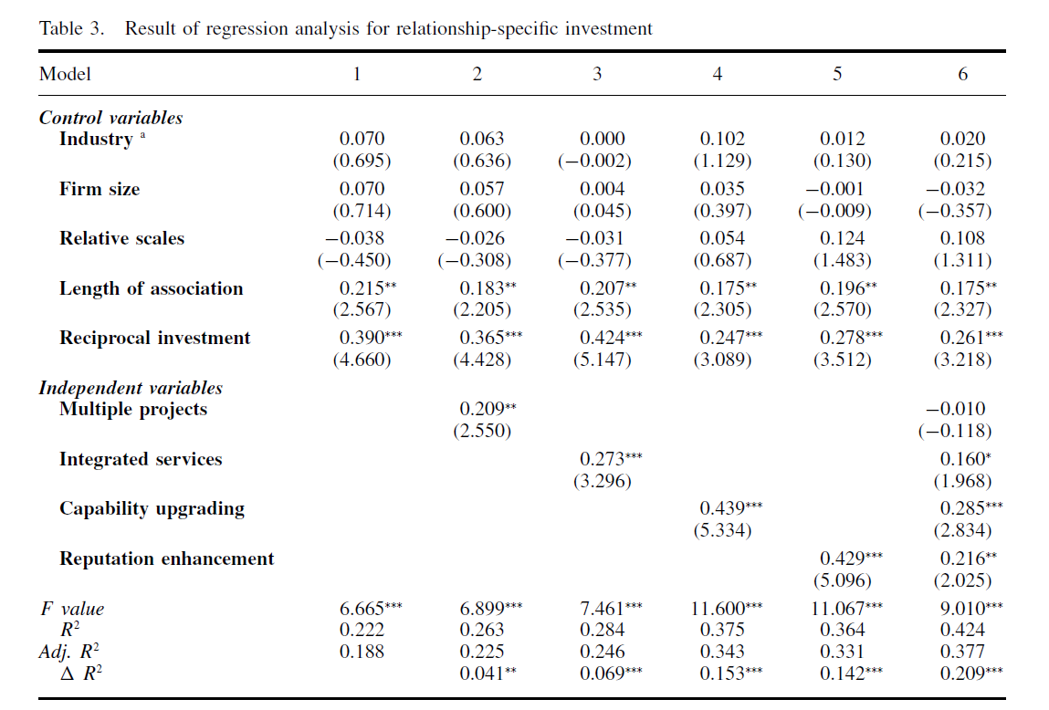
Introduction
Theory and Hypotheses
Method
Results
Discussion
H1
Knowledge spillover with a particular client:
H2
Knowledge spillover with other clients:
H3
Reputation spillover with other clients:

Slide 10
Introduction
Theory and Hypotheses
Method
Results
Discussion
Extend TCE in several ways:
Consider the positive economic values that an individual transaction could yield beyond the individual resource exchange between the transaction parties
Incorporate learning and capability development into governance choice and investment decisions
Consider strategic decisions regarding whether or not to invest and when to invest
Combine TCE and real options: It considers unilateral relationship-specific investment as an option in gaining preferential access to future opportunities (e.g., opportunities for capability development and reputation enhancement)

